Slide 1


Slide 2


Slide 3


Slide 4
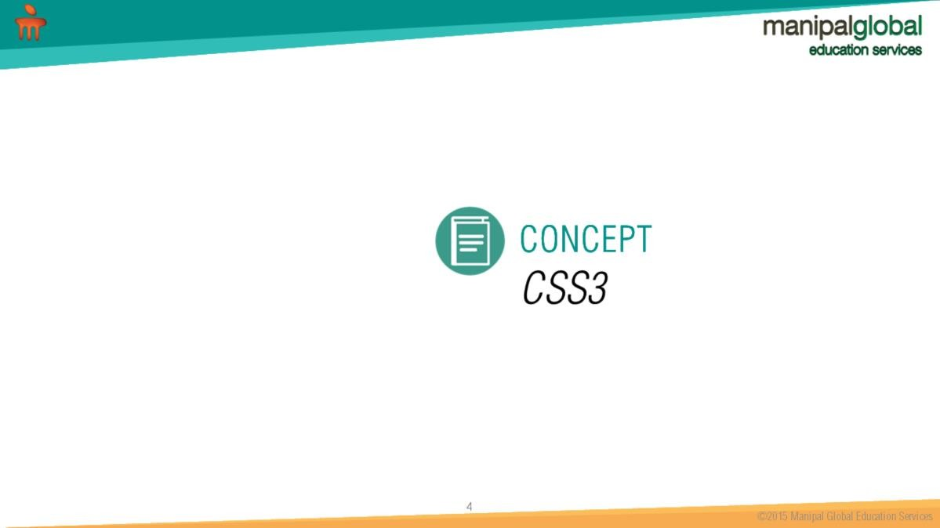

Slide 5
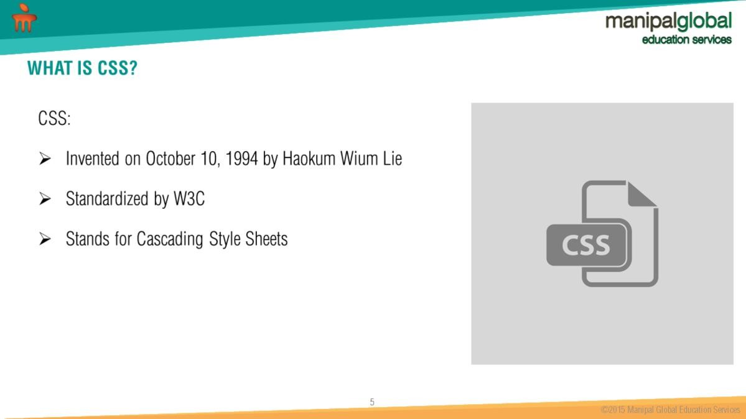
CSS can be internal or external to a HTML program If it is external then it is saved with .css extension.

Slide 6
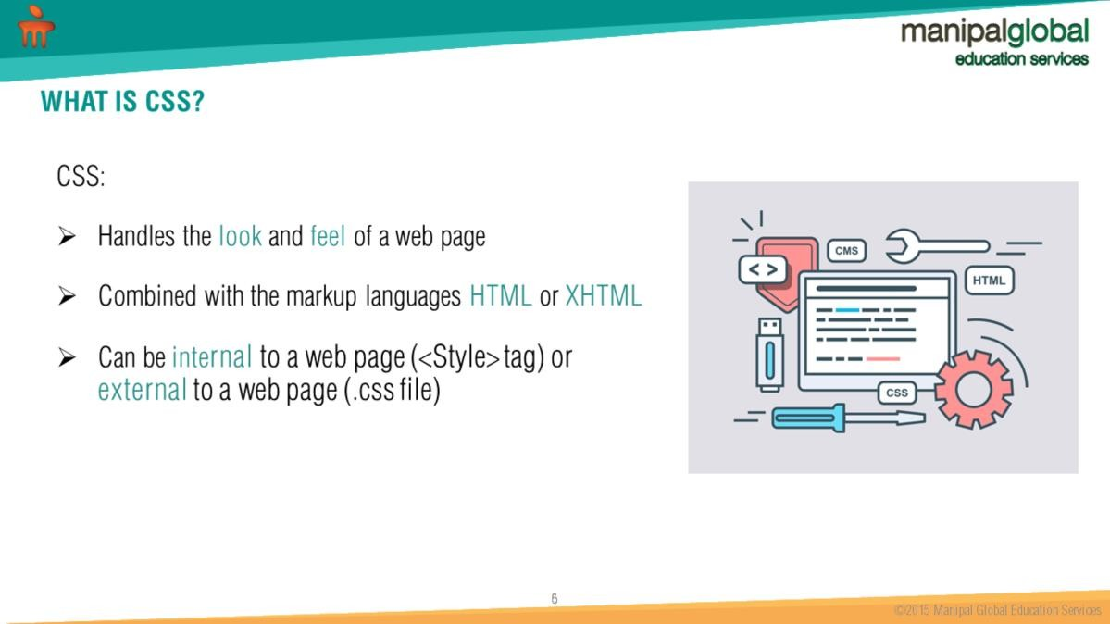
CSS enhances look and feel of a web page.

Slide 7
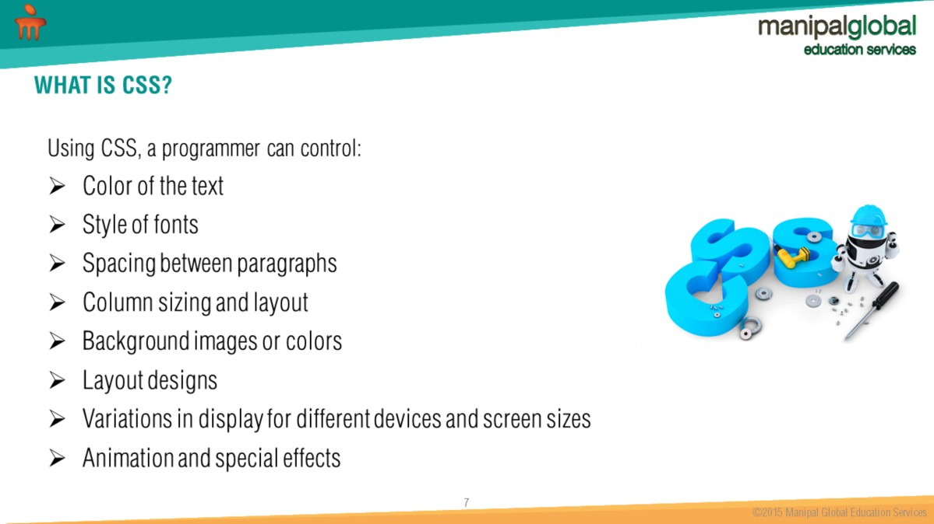
CSS can be used for working on color, fonts, layout, animation and different devices.

Slide 8


Slide 9
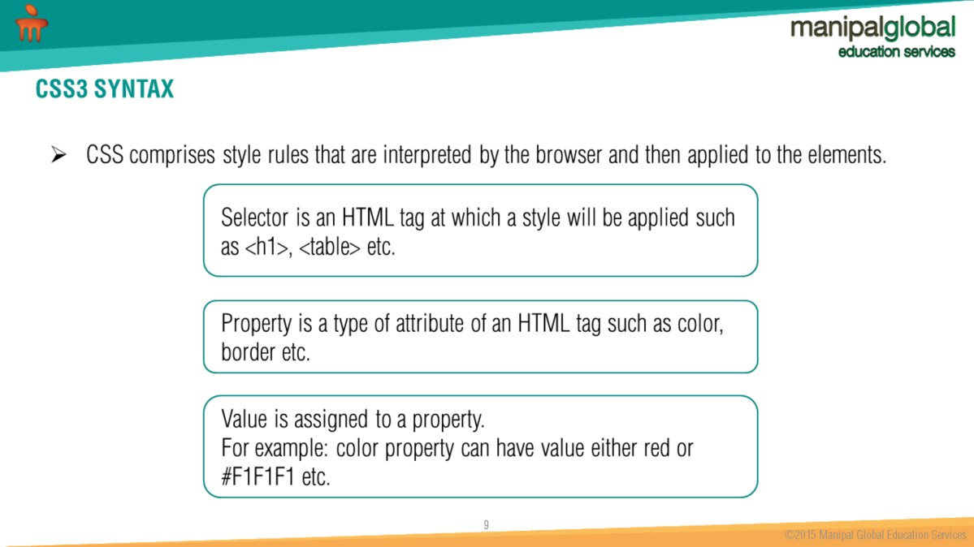
CSS can be applied on selector such as h1, table etc.
CSS can be applied on a specific element by identifiying the ID of the element.

Slide 10
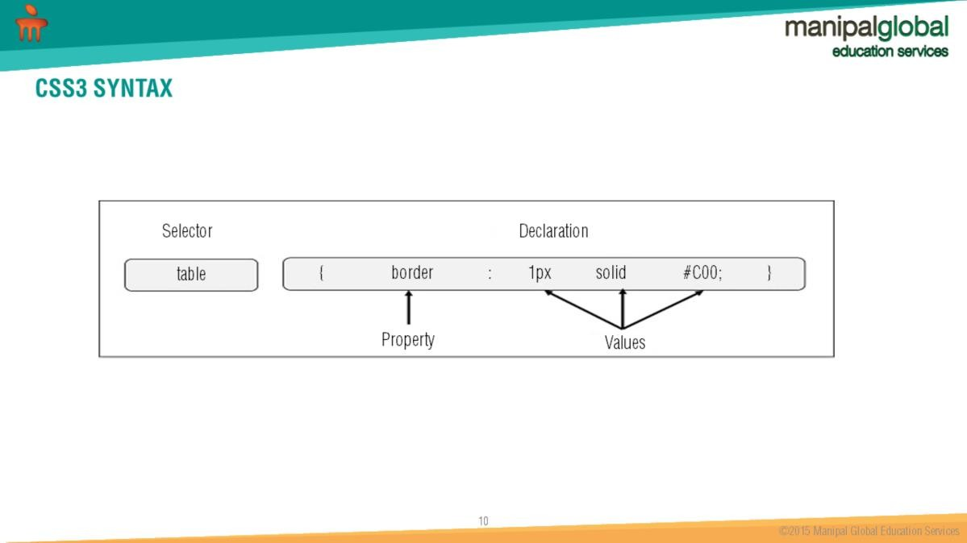
CSS has 3 parts i.e Selector, Property and values.

Slide 11
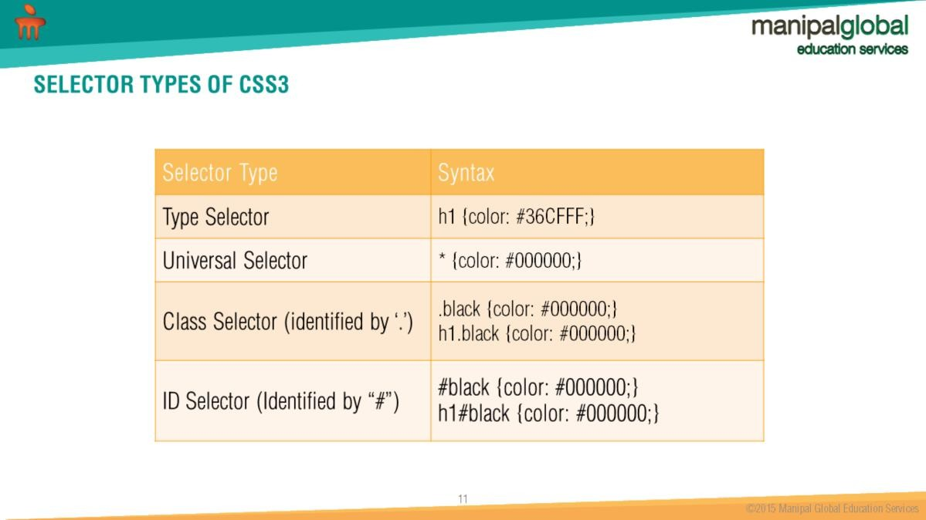
H1 -> Selector; color -> Property; #36CFFF -> value

Slide 12
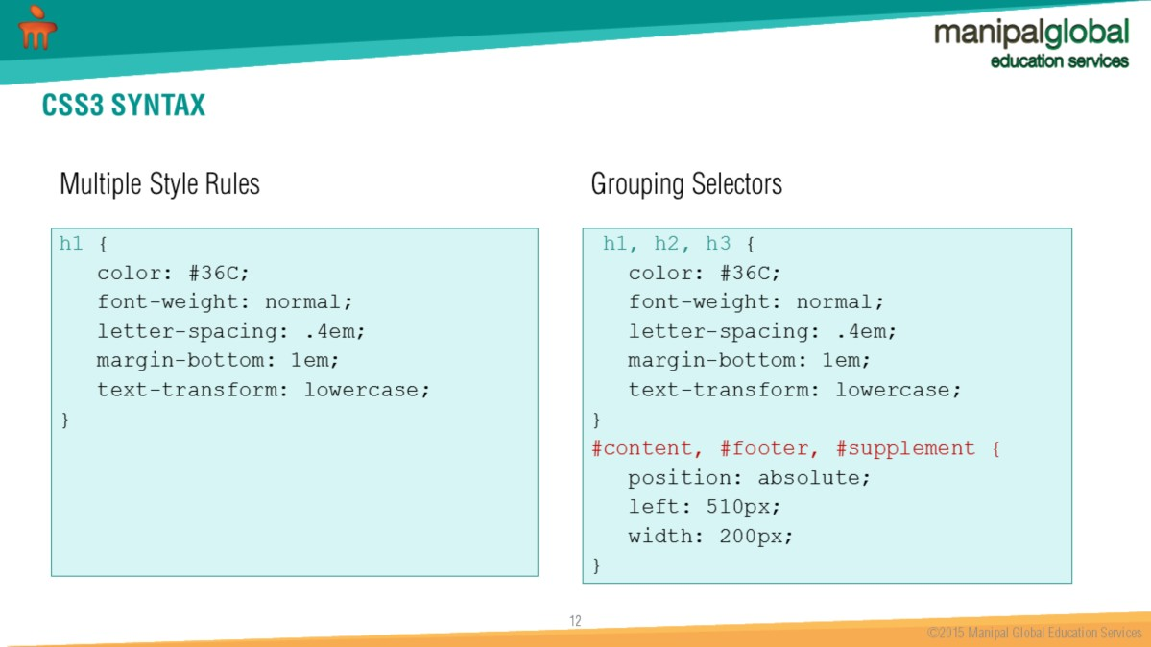
Values can be applied to more than one Selectors or IDs.

Slide 13
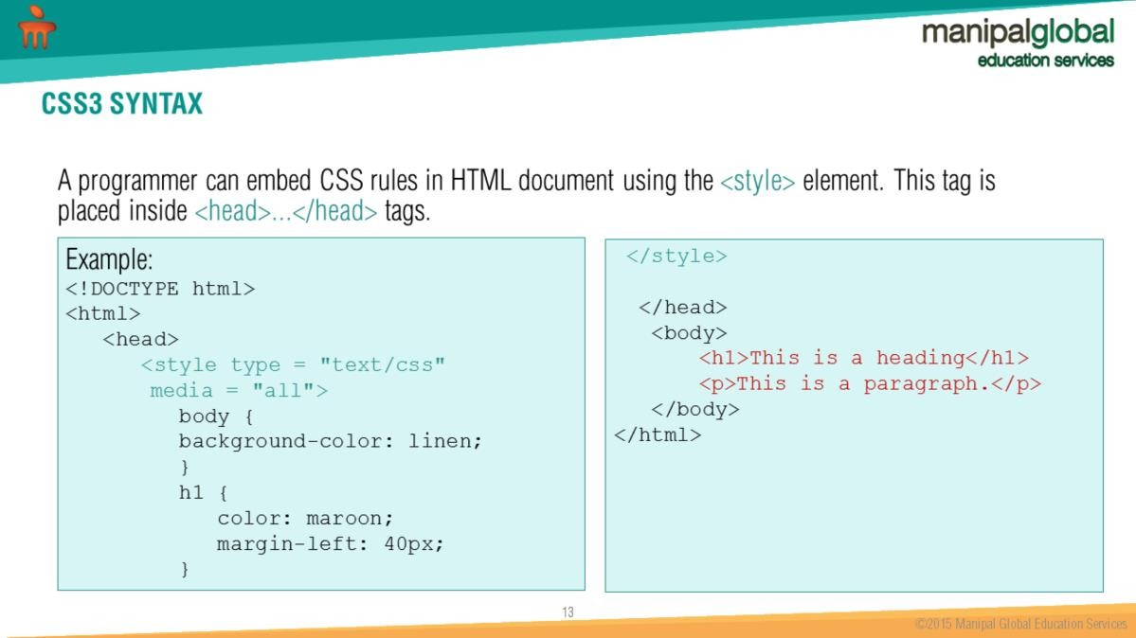
<style> tag is used to add internal CSS i.e inside a HTML file.

Slide 14
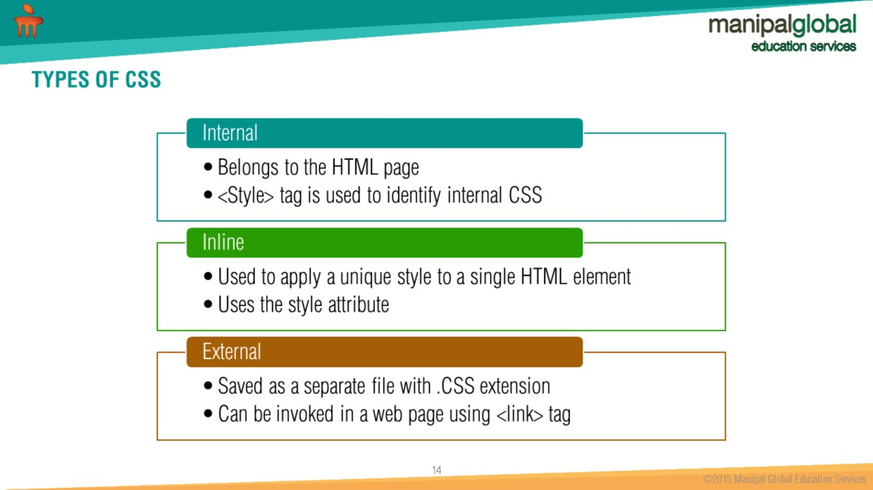

Slide 15
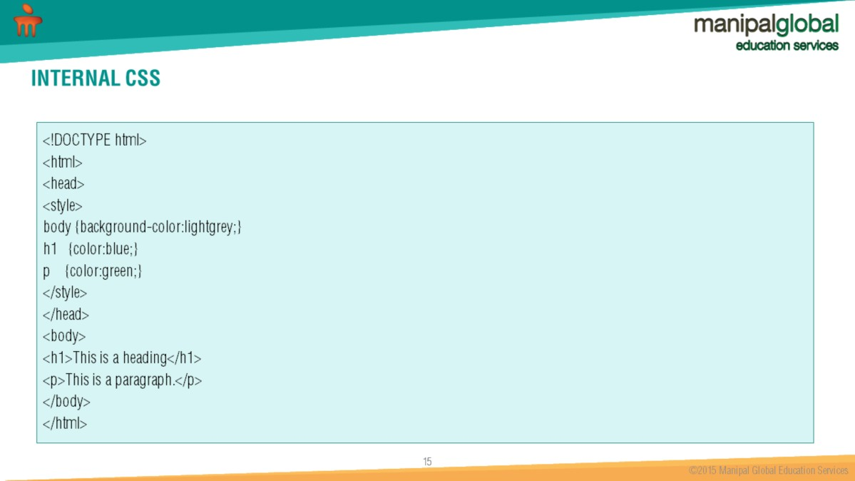

Slide 16
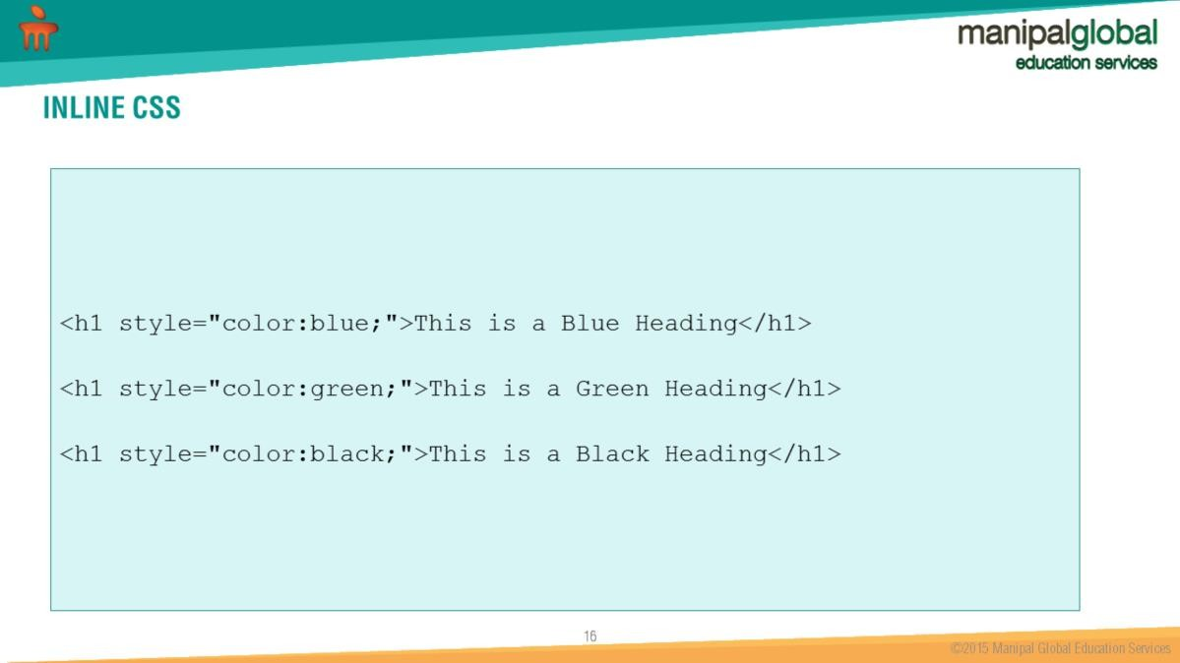

Slide 17
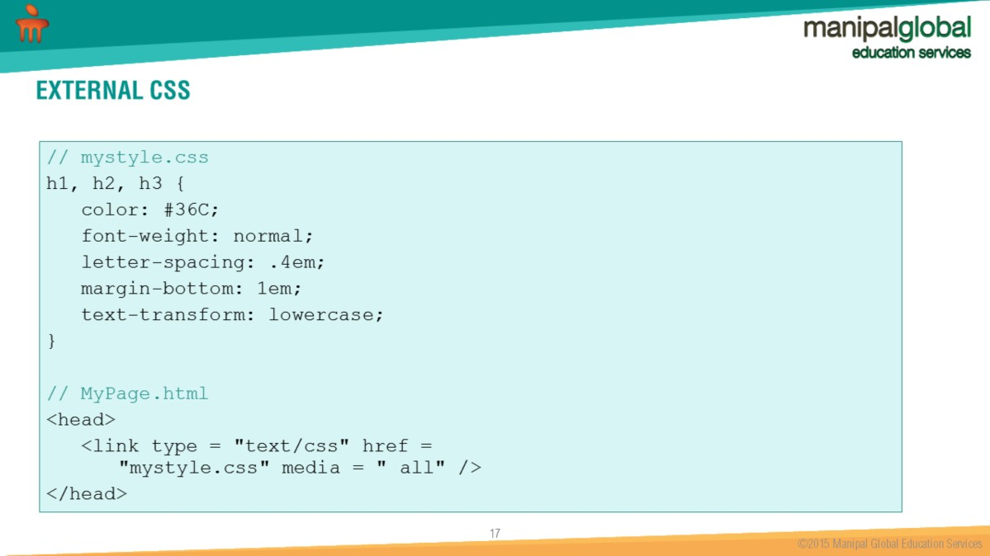
<link> tag is used to call a external css file in a HTML program.

Slide 18


Slide 19
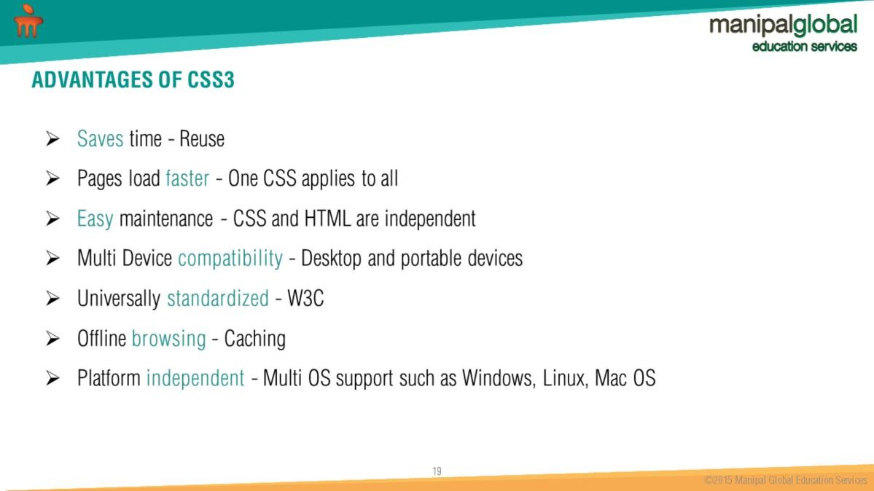
CSS helps in developing Platform independent styling.
With application cache it is easy to make an offline version of a web application, by
creating a cache manifest file.
Application cache means that a web application is cached, and accessible without an internet connection.
CSS can run on any operating system.

Slide 20


Slide 21
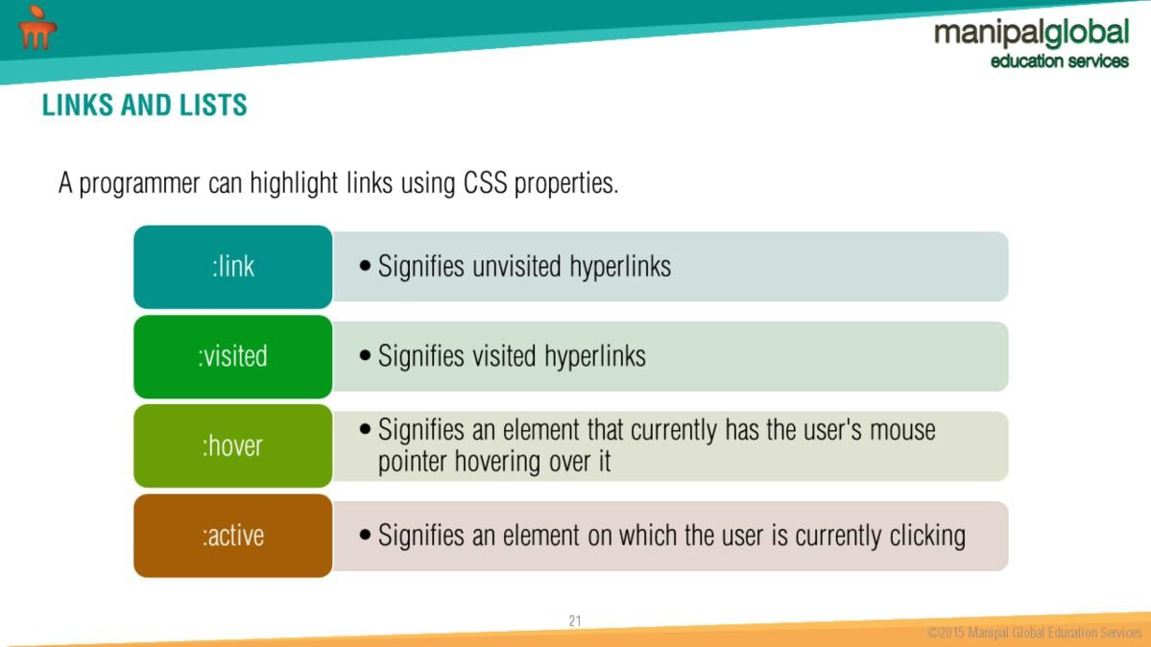
CSS has various properties such as link, visited, hover and active to highlight links.

Slide 22
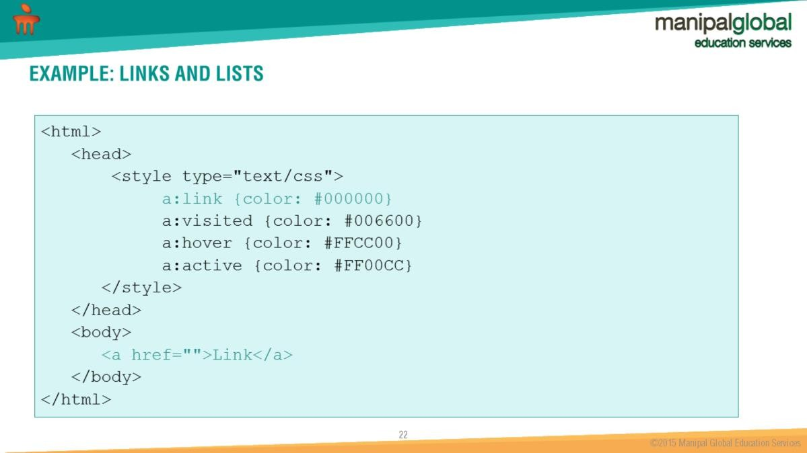
CSS properties can be used to highlight link colors.

Slide 23
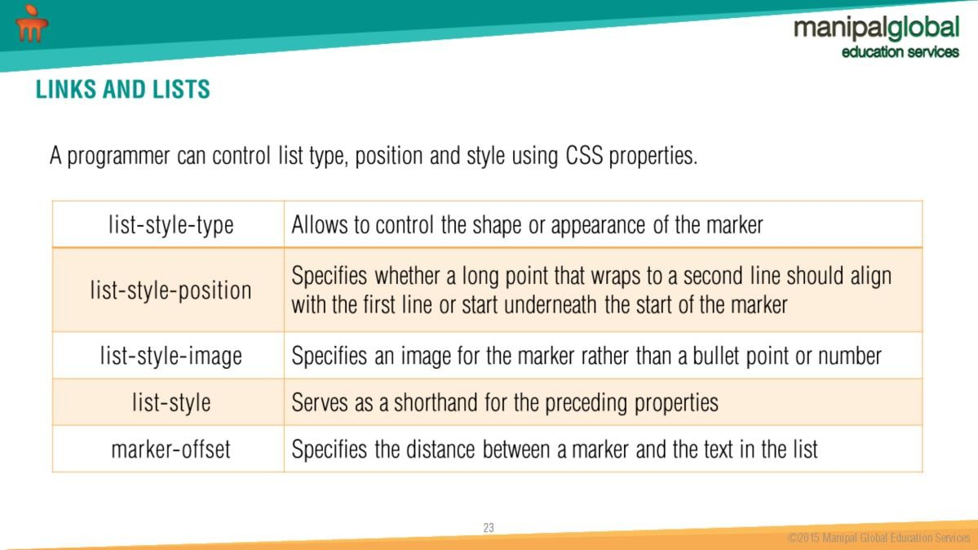
CSS can be used to control list type, position and style with CSS properties such as list-style-type, list-style-position, list-style, marker-offset.

Slide 24
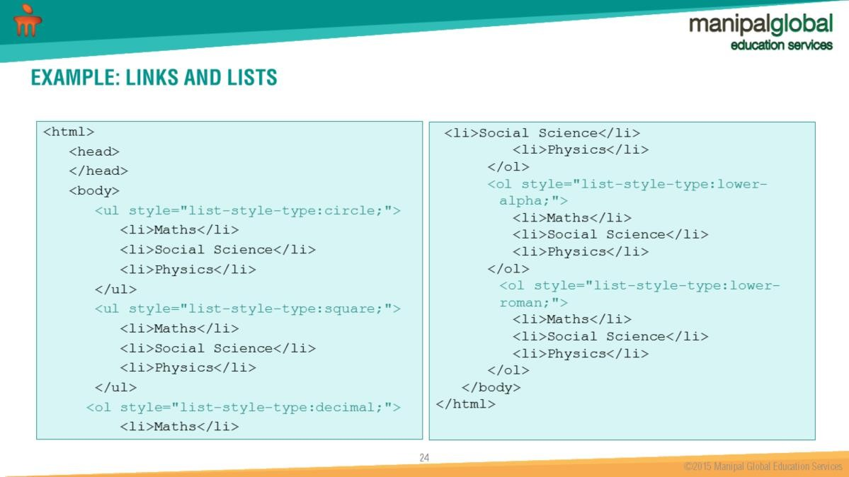
CSS can be combined with HTML lists

Slide 25


Slide 26
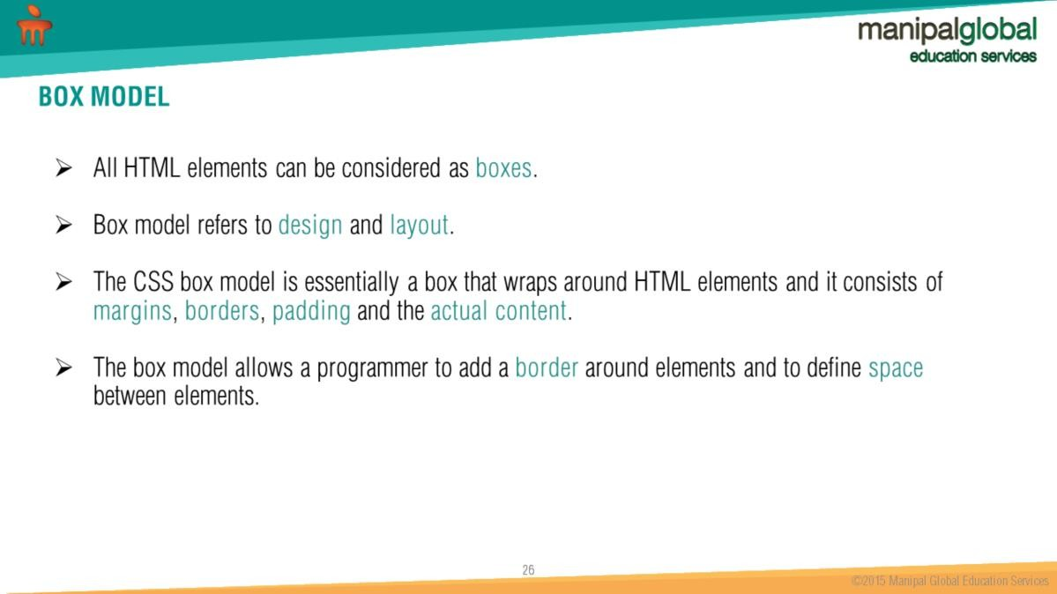
Box model identifies how content is rendered in CSS.

Slide 27
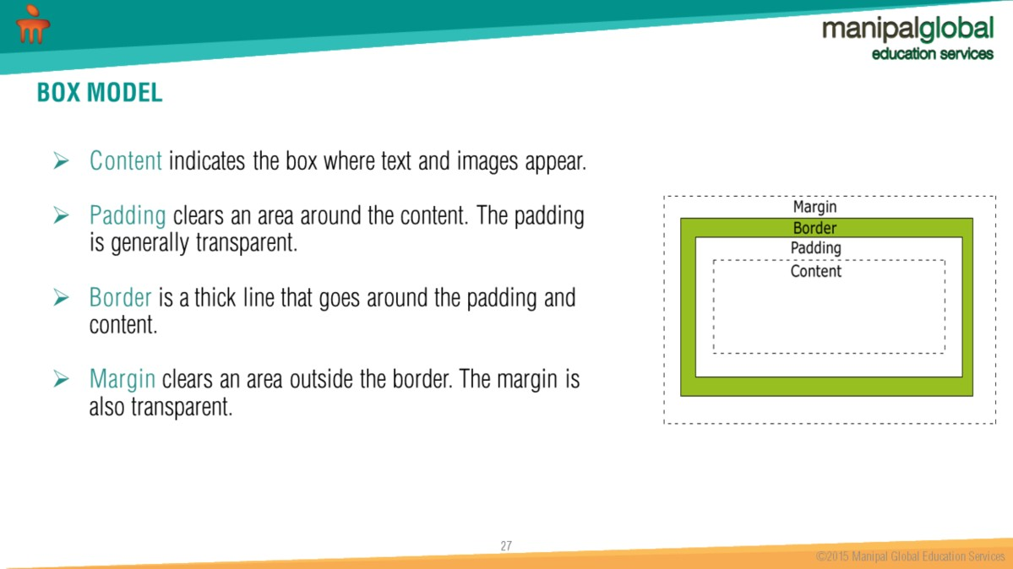
Box Model identifies 4 layers i.e content, padding, border and margin.

Slide 28
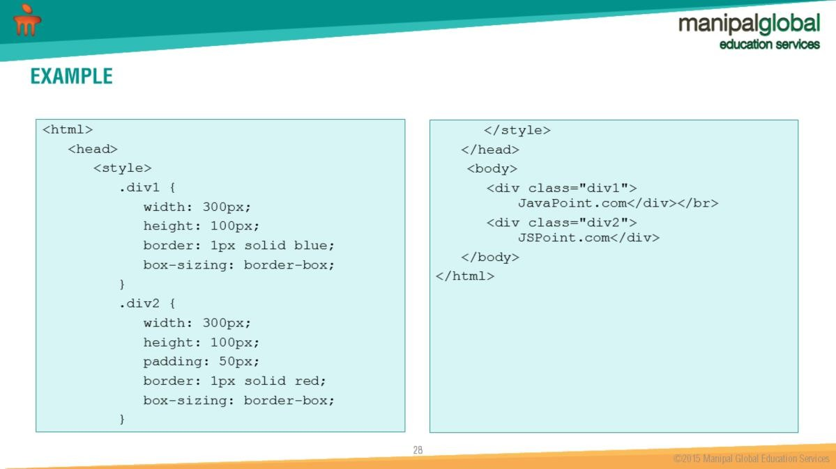
CSS Box model identifies how content has to be displayed on a web page.

Slide 29
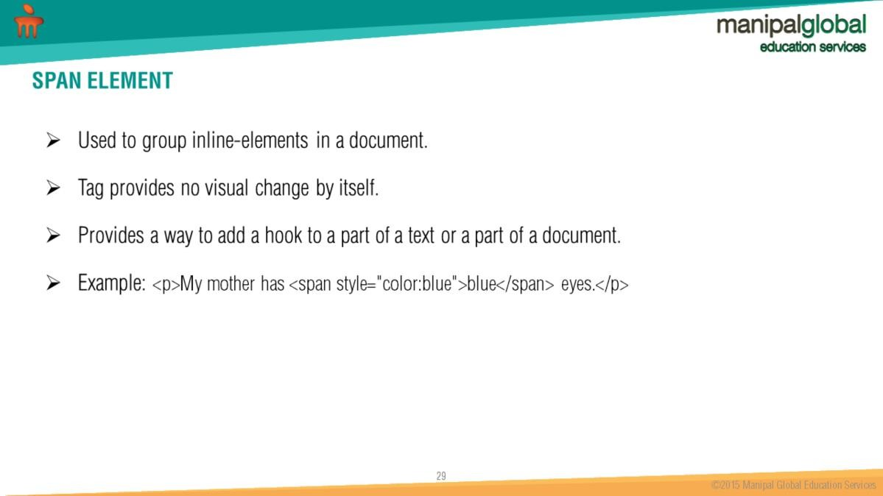

Slide 30

Answer : Haokum Wium Lie

Slide 31
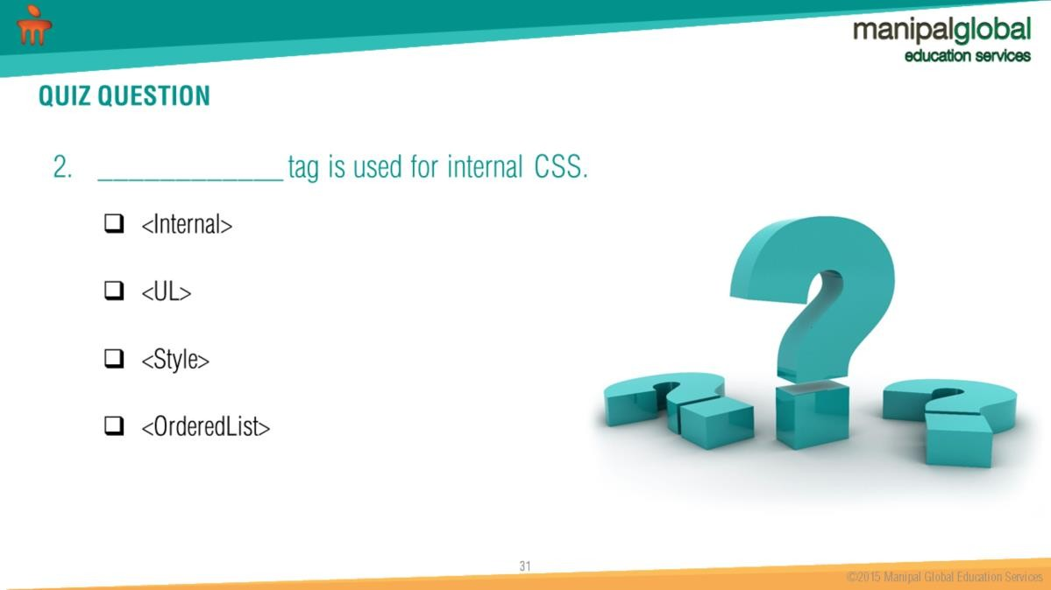
Answer : <Style>

Slide 32
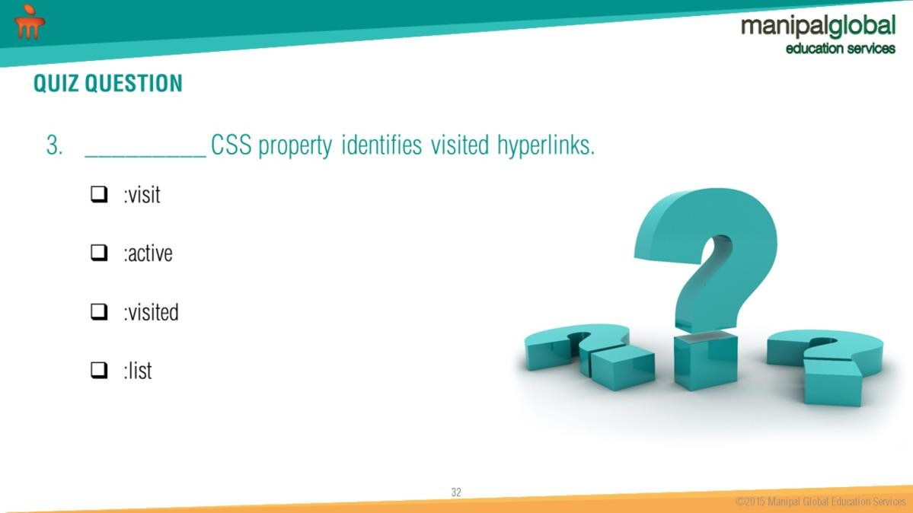
Answer: :visited

Slide 33
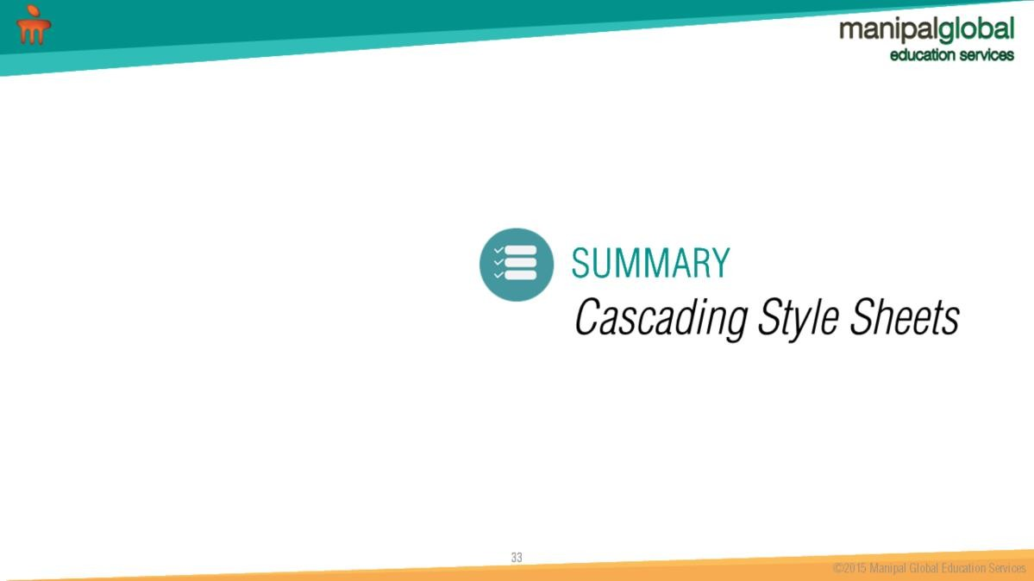

Slide 34
